Slide 1
Academic Research Enhancement Award (AREA) Program
April 29, 2014
Michelle M. Timmerman, Ph.D.
Director, AREA Program
National Institutes of Health

Slide 2
Overview of AREA (R15) program
How R15s differ from other Rs
Changes, trends, and funding
Strategies for success
Institutional level
PI level

Slide 3
Goals of AREA program
Support meritorious research
Expose students to research
Strengthen the research environment of the institution

Slide 4
Purpose of AREA Program
Support small-scale research projects in the biomedical and behavioral sciences
conducted by faculty and students
in educational institutions that have not been major recipients of NIH research grant funds

Slide 5
Key features
Project period is limited up to 3 years
Direct cost limited to $300,000 over entire project period
Multiple PIs are allowed, if all eligible
Research Strategy limited to 12 pages
Grants are renewable
Preliminary data not required but can be provided

Slide 6
Application logistics
Funded through the R15 grant mechanism
Program Announcement (PA) Number: PA-13-313
Receipt dates
Standard application deadlines: February 25, June 25, and October 25
AIDS-related research deadlines: May 7, September 7, and January 7
All NIH ICs participate in the AREA program except FIC, NIMHD, and NCATS

Slide 7
Differences between R15 & other Rs
Unique review criteria
Unique application requirements
Eligibility
Institution
PI

Slide 8
Some review criteria are unique
PA-12-006 & PA-13-313
Investigator
Experience supervising students in research?
Approach
Can project stimulate students’ interest so they consider biomedical/behavioral science career?
Environment
Well qualified students available?
Have or likely will students pursue biomedical/ behavioral science careers?

Slide 9
Overall
“Important scientific contribution”
Expose students to research
Strengthen research environment

Slide 10
Addition to PI biosketch
Summary of previous/current experience supervising students in research
Specify which pubs/patents involved students under their supervision
Publication = published or in press/accepted
Publication ≠ submitted or “accepted pending revision”

Slide 11
Additions to Facilities
For institution or qualifying College/School
Profile of students
Estimate of # who obtained Bachelor & went on to doctoral degree in last 5 years
Special characteristics that make it appropriate for 3 goals of AREA
Impact of R15 on PI & institution
Any institutional support
Limited use of special facilities elsewhere

Slide 12
Examples of institutional support
Equipment
Lab space
Release time
Matching funds
Items PI will not be charged for (e.g., no per diem for animals)
Pilot funds
Supply funds for student research
Summer stipends for student researchers

Slide 13
Eligibility
Eligibility
Institution
Principal Investigator
Eligibility = applicant institution and PI only
Eligibility ≠ collaborators

Slide 14
Institution eligibility
US institutions only
Baccalaureate or advanced degree in biomedical or behavioral science
Accredited (i.e., degree granting)
Receives less than $6 million per year in NIH support in 4 out of last 7 years

Slide 15
There is no “eligible” list
Ineligible list is on AREA Program website
http://grants.nih.gov/grants/funding/area_ineligible.htm
“College” is called “School”
City listed does not necessarily mean that campus only
Name might not be what appears on your application
“Other Academic” = sum of everything that is not an R15-defined Health Professional School

Slide 16
Most frequent question
I am part of a larger entity that is not eligible.
Is my particular sub-entity eligible?

Slide 17
Is health professional school considered separately from Other Academic?
Accredited
by a recognized body approved by Secretary of Education
e.g., degree is issued by component not university
Different that programmatic accreditation
Terminal health science degree
PhD, MD, DO, DVM, OD, DDS, DPT, DC, ND, BSN
Impact on this unit is evaluated

Slide 18
Can a satellite campus be considered separately from the flagship?
What is accredited? Where is degree issued?
At level of flagship campus = not considered separately
At level of satellite campus = considered separately

Slide 19
PI eligibility
Primary appointment at eligible institution
OK:
Also serve as consultant (e.g., Key Personnel) on another grant
Serve as PD of training grant at time of award
Not OK:
Also serve as PI of other research grants at time of award
Also serve as Multiple PI on another research grant at time of award

Slide 20
Second most common question
Can I have a collaborator who is not at an AREA-eligible institution, at home campus or another site?
Eligibility answer: Yes
Merit answer: But keep the unique goals and criteria of the R15 in mind
No one can predict what level of involvement will be seen as counter to the R15 goals
Pre-PA-12-006, unique attributes not included as strongly in review criteria

Slide 21
Changes to R15 over time
Now considered career-long, no longer stepping stone to R01
Renewable
Now clear incorporation of R15 goals in review criteria
Now softened language about expected scientific impact

Slide 22
Funding statistics FY11-13
NIH wide: ~1400-1500 applications, ~200 awards
# applications & awards vary widely among ICs, and not just by size of IC
Similar success rate to other research grants
http://report.nih.gov/frrs/index.aspx (“Academic Research Enhancement Awards (AREA): Success rates by IC”)

Slide 23
FY 13 Funding by Institute/Center (IC)
Institute/ Center | Applications reviewed | Applications funded | Success rate
NIAAA | 21 | 1 | 4.8%
NIA | 61 | 2 | 3.3%
NIAID | 159 | 23 | 14.5%
NIAMS | 52 | 4 | 7.7%
NCCAM | 19 | 3 | 15.8%
NCI | 215 | 28 | 13.0%
NIDA | 28 | 4 | 14.3%
NIDCD | 25 | 2 | 8.0%
NIDCR | 25 | 2 | 8.0%
NIDDK | 76 | 5 | 6.6%
NIBIB | 49 | 3 | 6.1%
NIEHS | 49 | 10 | 20.4%
NEI | 24 | 4 | 16.7%
NIGMS | 304 | 45 | 14.8%
NICHD | 138 | 14 | 10.1%
NHGRI | 1 | 0 | 0.0%
NHLBI | 122 | 17 | 13.9%
NLM | 4 | 0 | 0.0%
NIMH | 58 | 10 | 17.2%
NINR | 36 | 6 | 16.7%
NINDS | 102 | 14 | 13.7%
FY13 Total | 1568 | 197 | 12.6%

Slide 24
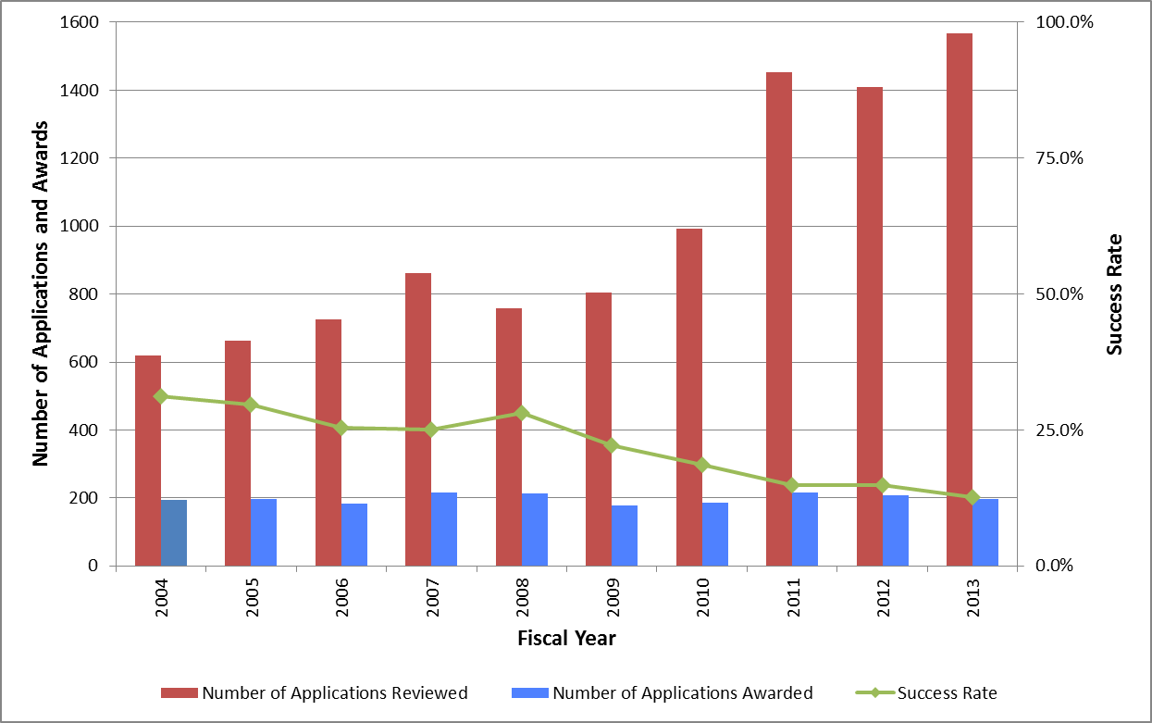
FY04-13 Funding trends

Slide 25
FY13 distribution of R15 awards
“NIH Awards by Location & Organization” search terms: PA-12-006, FY13
http://www.report.nih.gov/award/index.cfm?ot=&fy=2013&state=&ic=&fm=RP&orgid=&distr=&rfa=PA-12-006&om=n&pid=#tab4

Slide 26
FY13 Geographic trends
47 states + DC + PR have 1+ R15 reviewed & awarded for FY13
Average = 4.1 R15 awards/’state’
Range = 0 – 15
4 states with >9 awards
FL, MI, NY, OH

Slide 27
Strategies for success
Institution
Investigator

Slide 28
Build a vital research environment
Understand the NIH extramural research program
Know guidelines, deadlines, submission & correction process, and review criteria
Make a commitment to establishing an environment in which research can succeed
Start up packages for equipment and supplies
Pilot grants, student research grants
Credit for student involvement in research
Consider the importance of collaborative research in establishing a successful research environment

Slide 29
…Build a vital research environment
Do not pressure investigators to apply if their projects are not ready for peer review
Quality over quantity; submit best application
“Get some feedback from the reviewers”
Help investigators with the “Facilities and Other Resources” section of application
Profile of student body
Description of the institution and research environment
Letter of institutional commitment to research project
Maintain as resource & revise per Summary Statements

Slide 30
Strategies of Successful PIs
Include a collaborator or consultant if you don’t have the necessary expertise or resources
Understand the review criteria and the review criteria questions
Each question should be addressed in the application
In A1, respond thoroughly and diplomatically to all of the reviewer comments
AREA grant is research award, not training award
Focus on hands-on research not course work
Describe PI’s role in research & supervision

Slide 31
…Strategies of Successful PIs
Address the AREA-specific programmatic goals in the application
Support meritorious research
Research should contribute to the field
Results should be publishable
Expose students to research
Profile of available and former students at the institution
Experience of the investigator in working with students
How students will be incorporated into the research project
How students will benefit from this research experience
Strengthen the research environment
The suitability of the institution for an award
The impact the AREA grant will have on the institution

Slide 32
There is no winning formula
No one can give specifics of what will score well
Do not treat a successful [or not] application as an iron-clad template [of what not to do]
How many students
How many papers
What % of a collaborator
What % of special facilities
What amount or type of institutional support
What type of environment

Slide 33
News & resources
AREA Program evaluation underway
Assessing Program’s success in meeting its goals
Surveys & interviews by Westat
AREA Program Facebook page
Like us on Facebook
https://www.facebook.com/NIHAreaProgram
AREA Program FAQs
http://grants.nih.gov/grants/funding/area_faq.htm
AREA mailbox
R151@mail.nih.gov

